Slide 1
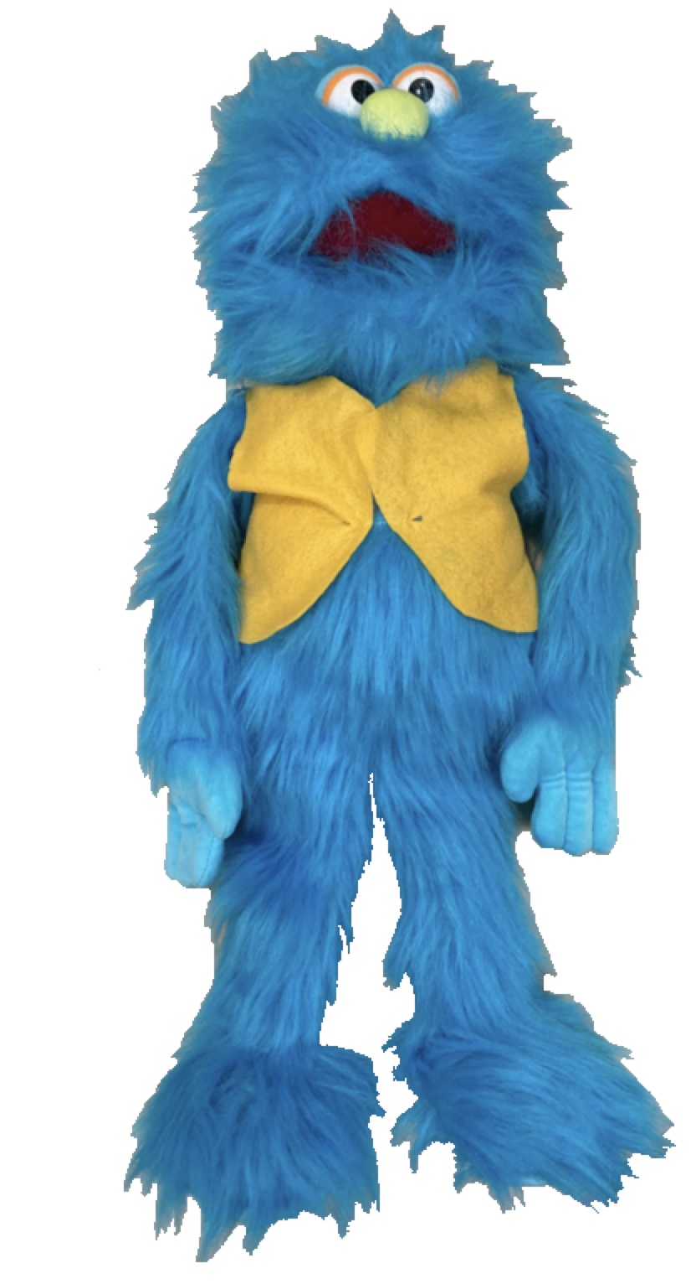
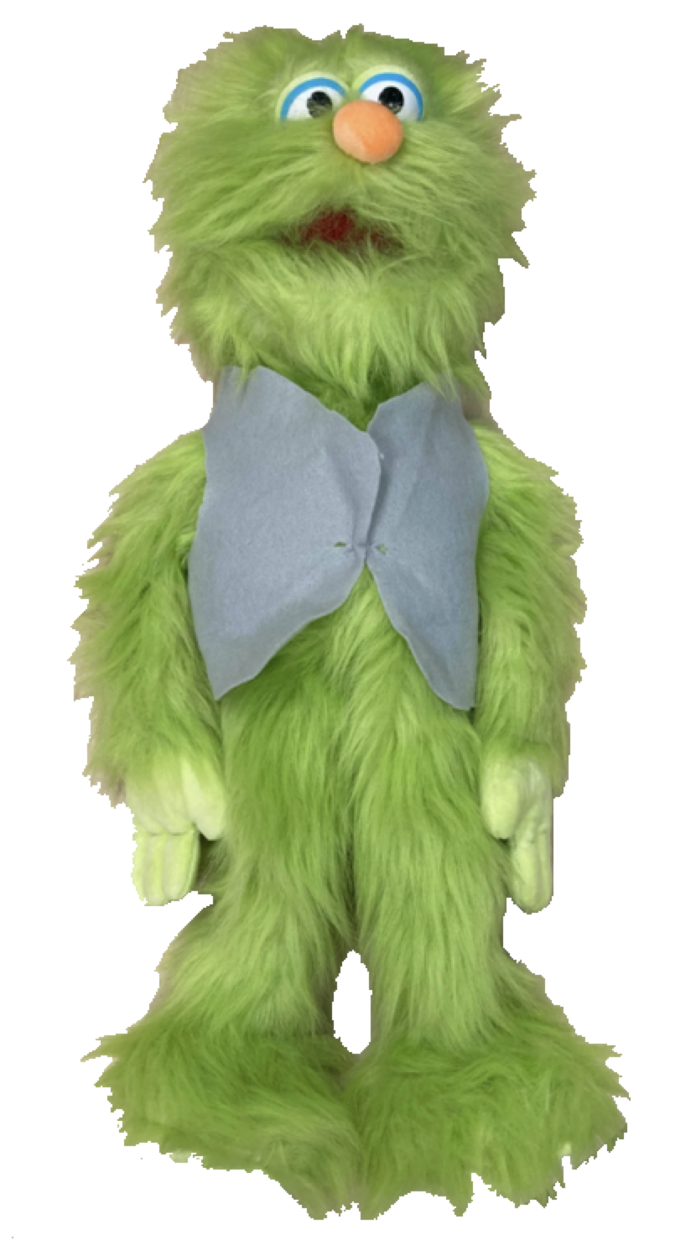
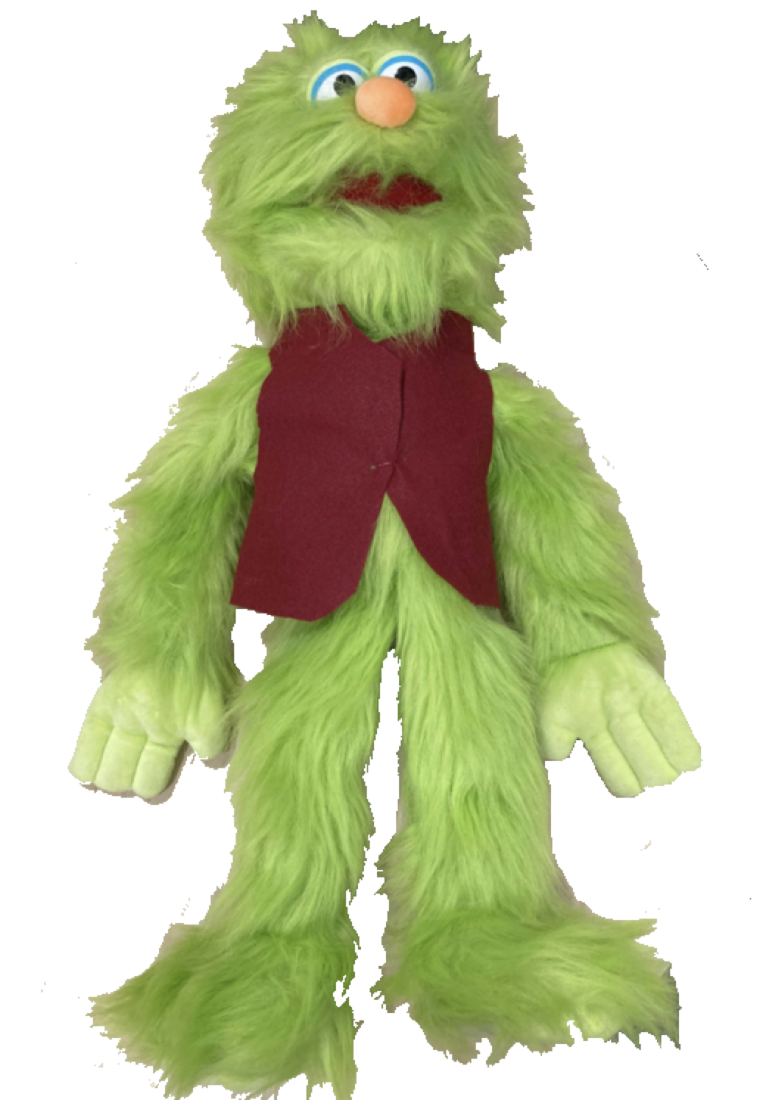
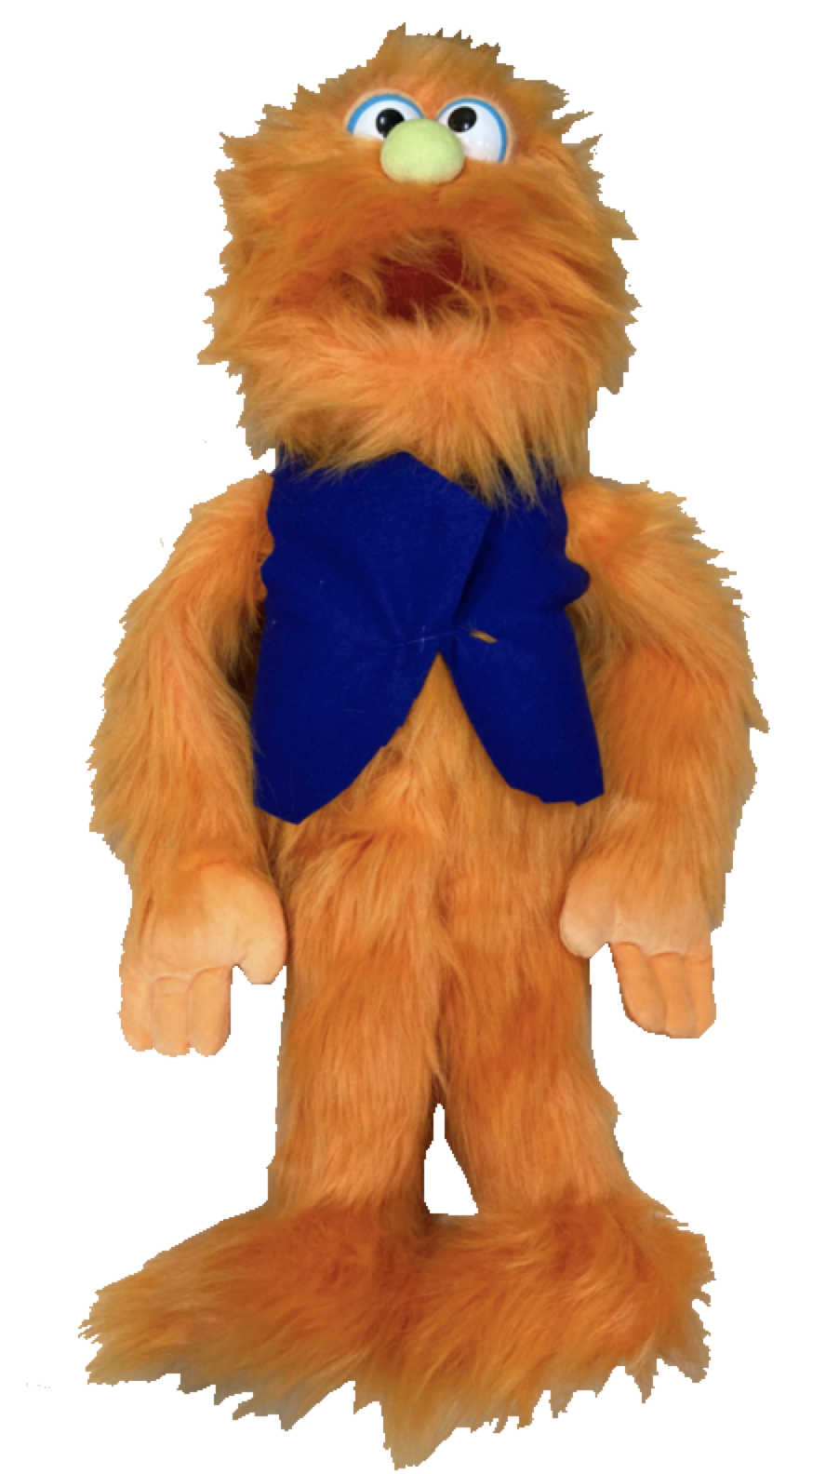
Notes:
Ok, let me first introduce you to these guys -- they’re called wubs! They don’t speak English though, they speak a different language called Jabberwocky
[configuration of wubs will be counterbalanced]

Slide 2

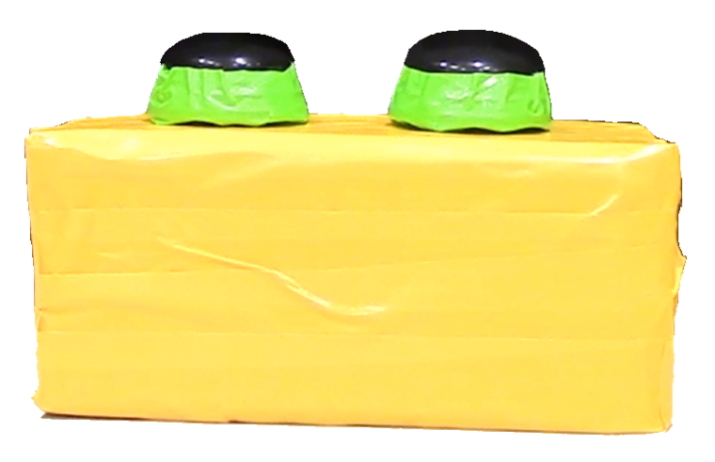
Notes:
And here’s a really cool toy. This toy rings when you press the right buttons. You have to press both of these buttons at the same time to make this toy ring! If you press just one of the buttons, the toy doesn’t do anything.

Slide 3

Notes:
But uh-oh, these green wubs have never seen the toy before, so they don’t know how to make the toy ring! But they really want to make the toy ring!
[configuration of wubs will be counterbalanced]

Slide 4
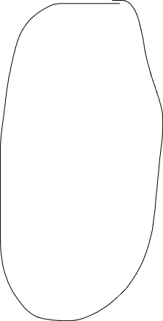
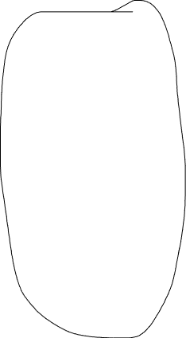
Notes:
But look! See this blue wub and see this orange wub?
ONE of these two wubs has played with the toy before and knows that you have to press both buttons to make the toy ring, but I’m not sure which wub knows. It could be the blue wub or it could be the orange wub !
But the videos we’re going to watch have some clues. So I really need your help – can you watch the videos very carefully and help me figure out whether the blue wub or the orange wub really knows how to make the toy ring?
[configuration of wubs will be counterbalanced]

Slide 5
Notes:
The first video is going to be about this blue wub and this green wub.
[Order of videos will be counterbalanced]

Slide 6
Video 1 (postfail_blue_speech)
Notes:
Let’s watch!
What do you think the blue wub said to the green wub?
[Order of videos will be counterbalanced]

Slide 7
Notes:
The second video is going to be about this orange wub and this green wub.
[Order of videos will be counterbalanced]

Slide 8
Video 2 (prefail_orange_speech)
Notes:
Let’s watch!
What do you think the orange wub said to the green wub?
[Order of videos will be counterbalanced]

Slide 9
Which one knows how to make the toy ring?
Notes:
Ok, so those were the two videos! Now, remember, only one of these wubs here knew that you have to press both buttons on the toy to make it ring– now we need to figure out whether it was the BLUE wub or the ORANGE wub that really knew! Which wub knew that you have to press both buttons on the toy at the same time to make it ring, the blue wub or the orange wub?
[configuration of wubs will be counterbalanced]

